Slide 1
Power System Fault Detection and Classification
CAPSTONE PROJECT
Presented By:
1. Vinitha Enagandula-Jyothishmathi Institute Of Technology and Science-Computer Science and Engineering

Slide 2
OUTLINE
Problem Statement
Proposed System/Solution
System Development Approach
Algorithm & Deployment
Result
Conclusion
Future Scope
References

Slide 3
Problem Statement
The objective of this project is to design a machine learning model to detect and classify faults in a power distribution system using voltage and current phasor data. The model should accurately distinguish between normal conditions and fault types such as line-to-ground, line-to-line, and three-phase faults. This will enable rapid and reliable fault identification, essential for maintaining power grid stability and operational safety.

Slide 4
Proposed Solution
To address the challenge of rapid and accurate fault identification in power distribution systems, we propose a supervised machine learning-based solution that leverages electrical measurement data (voltage and current phasors) to detect and classify various types of faults.
Data Collection:
Data Preprocessing:
Filter and normalize the voltage and current signals to remove noise and scale features consistently.
Segment and extract features (e.g., RMS values, phase differences) from time-series data for model input.
Machine Learning Algorithm:
Train supervised learning models like Random Forest, SVM, or XGBoost on extracted features for fault classification.
Use CNN or LSTM architectures if working with raw time-series data to capture spatial and temporal patterns of faults.
Deployment:
Integrate the trained model into a real-time monitoring system using edge devices or cloud services for on-site fault detection.
Connect the system to SCADA or protection relays to trigger automatic alarms or control actions when faults are identified.
Evaluation:
Assess model performance using accuracy, precision, recall, F1-score, and confusion matrix on a separate test dataset.
Measure inference time and robustness under noisy or varied operating conditions to ensure suitability for real-time deployment.
Result:
Simulate voltage and current phasor data under normal and fault conditions using tools like MATLAB/Simulink.
Label each dataset with the corresponding fault type (e.g., LG, LL, LLL) for training the machine learning model.

Slide 5
System Approach
Use phasor measurement data acquisition, followed by preprocessing and feature extraction to prepare inputs for the machine learning model.
Deploy the trained model in a real-time fault monitoring system that classifies faults and interfaces with grid control systems for automated response.

Slide 6
Algorithm & Deployment
This solution uses machine learning (ML) techniques for classification and is aimed at real-world deployment readiness.
Algorithm Selection:
Suitable for structured tabular data like RMS voltages, currents, and fault indicators.
Offers high accuracy with fast inference — ideal for real-time fault classification at substations.
Data Input:
Time-series measurements of voltage and current phasors (magnitude and phase angle) from sensors or PMUs.
Extracted features like RMS values, sequence components, and rate of change for accurate fault characterization..
Training Process:
Preprocess raw voltage/current data to extract features (RMS, angles, sequence components) and label each instance (e.g., Normal, LG, LL, LLG, 3-Phase).
Prediction Process:
Real-time voltage and current phasor data are fed into the system from sensors or PMUs.

Slide 7
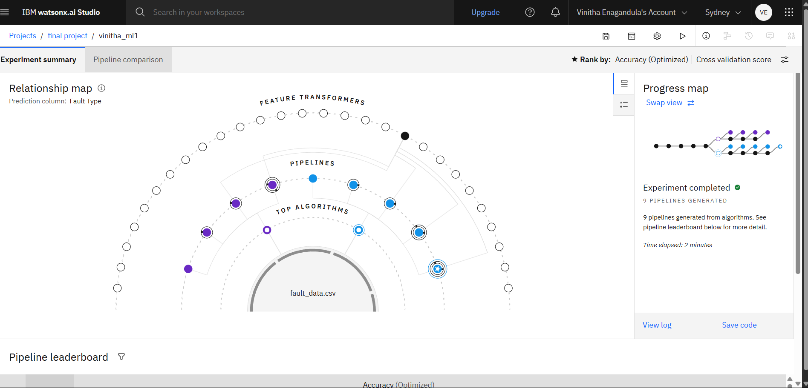
Result

Slide 8
Conclusion
The implementation of a machine learning-based fault detection and classification system significantly enhances the reliability and responsiveness of power distribution networks. By analyzing real-time electrical measurements such as voltage and current phasors, the model accurately identifies fault types—including line-to-ground, line-to-line, and three-phase faults. This intelligent prediction process ensures faster fault localization, reduces downtime, and supports efficient maintenance, thereby contributing to a more stable and resilient power grid.

Slide 9
Future scope
The proposed fault detection and classification system holds significant potential for future enhancements. One promising direction is its integration into smart grid infrastructures, enabling automated fault isolation and system self-healing capabilities. Real-time deployment on edge devices at substations can further reduce latency and support immediate decision-making, even in remote areas.

Slide 10
References
The concepts and methodologies used in this project are inspired by various research works on fault detection in power systems, including studies on machine learning applications for real-time classification, use of phasor measurement units (PMUs), and smart grid integration strategies as outlined in recent IEEE publications and academic journals.

Slide 11
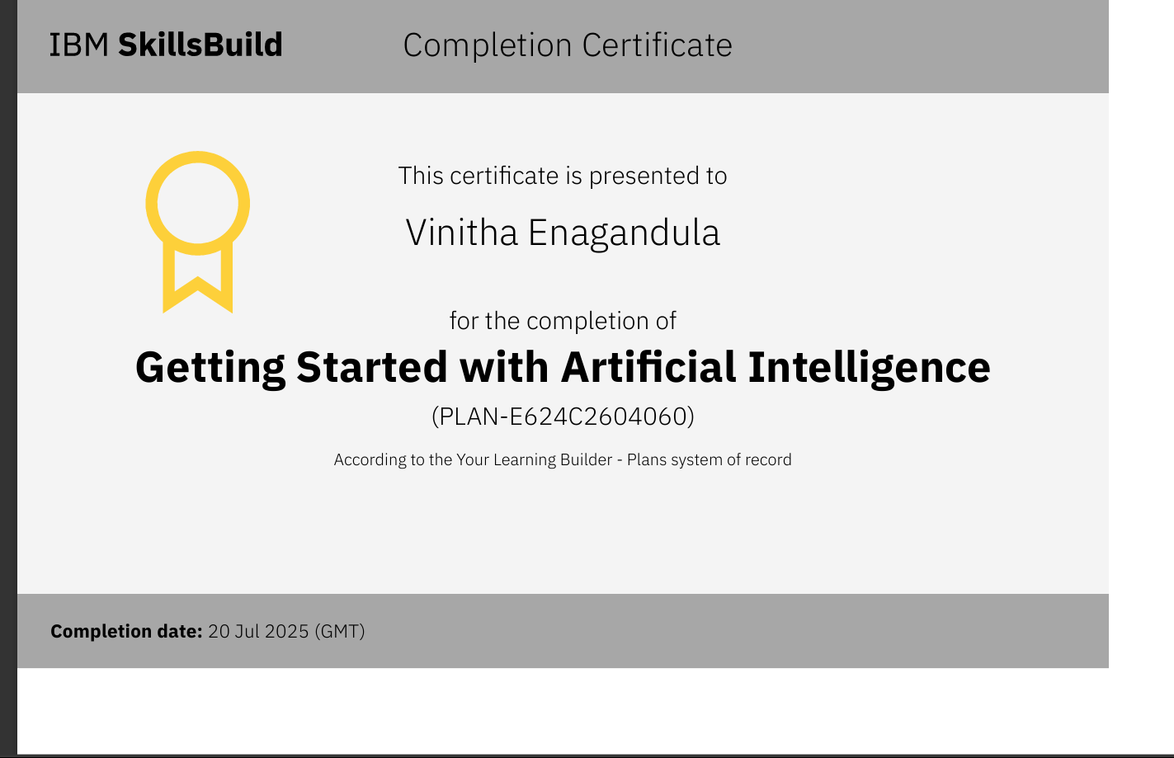
IBM Certifications

Slide 12
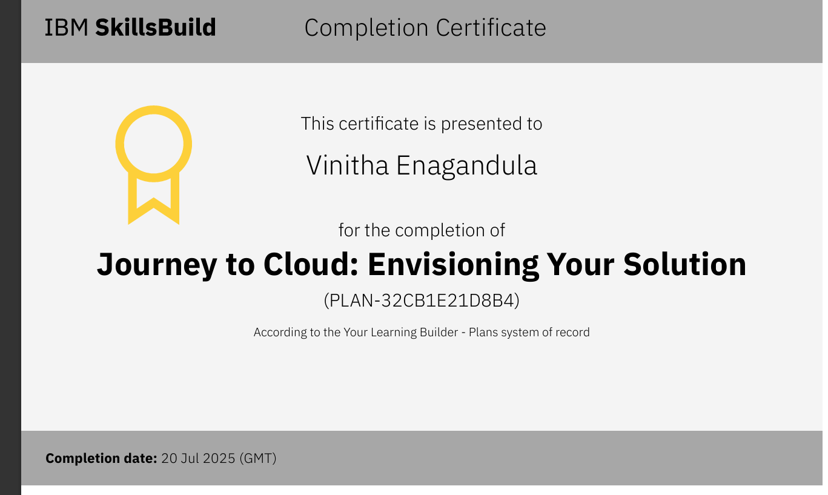
IBM Certifications

Slide 13
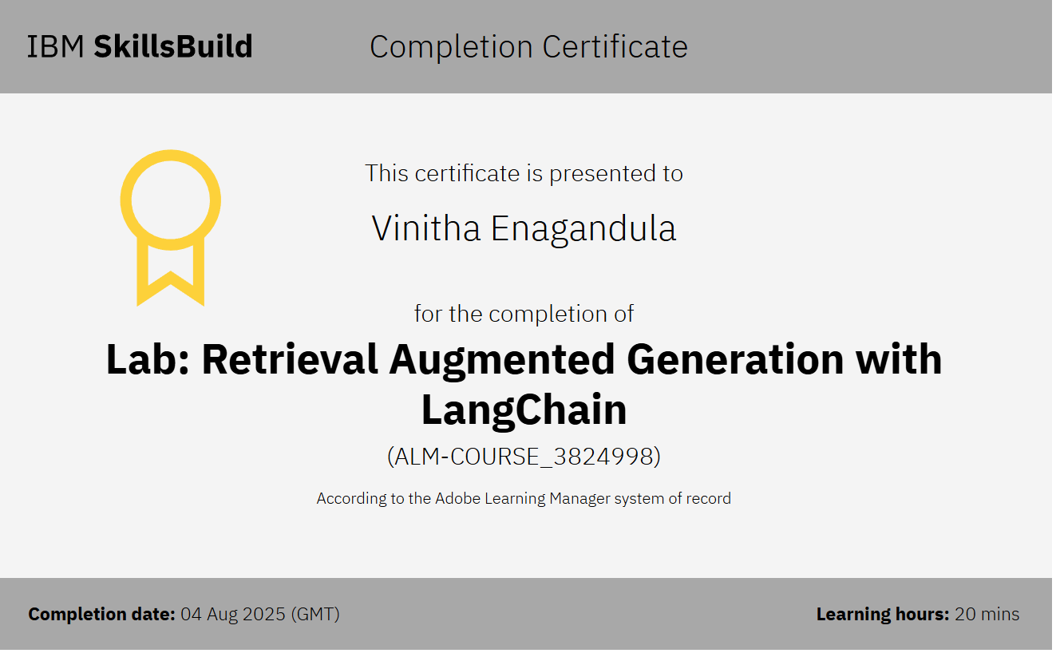
IBM Certifications

Slide 14
THANK YOU

